Slide 1
For increasing sales
Store analysis

Slide 2
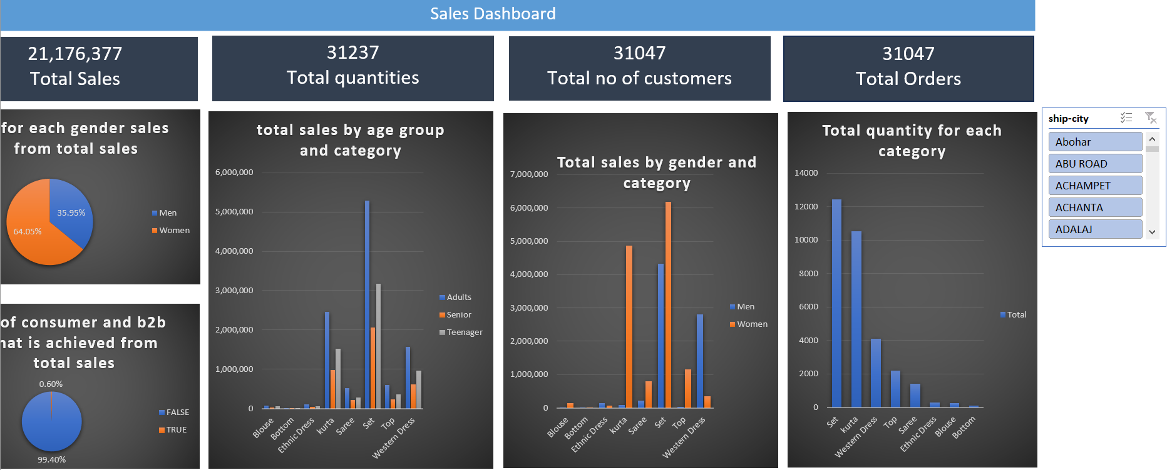

Slide 3
